Slide 1
AP Macroeconomics – Semester 2, Week 2

Slide 2
Unit 6 – International Trade
Unit 6 is all about the global market and how the flow of goods and services, investment and the performance of the macro economy is connected!

Slide 3
6.1 Balance of Payments
The balance of payments is a way of categorizing different flows of money into two main categories.

Slide 4
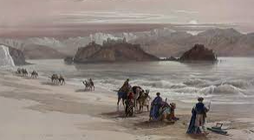
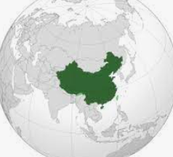


Trade and Money Flows across nations
Summary
We will extend our discussion of trade to all flows of money in and out of countries.
Trade along the ancient silk road.
Trade can be seen as the exchange of goods and services between different groups of people/locations.
In our globalized world not only is there a flow of goods and services but flows of money.
In this new topic we will examine not only trade but the movement of all flows of money between countries and how they are categorized.

Slide 5




Topic 6.1 Balance of Payment Accounts
Balance of Payments (BOP) is an accounting system to keep track of transactions between countries over a period of time.
As we first saw in the circular flow model, money enters and leaves the economy through injections and leakages. The balance of payments looks at these flows and categorizes the flows into two categories – the current account and capital account.
Summary
All movements of money between countries are classified either in the current account or capital/financial account.
Balance of Payments (BOP)
Current Account (CA)
Net exports
Net Investment income
Net Transfers
Money transfers
Net unilateral transfers
Capital and Financial Account
Net purchase of assets between countries
Net Financial capital transfers
Whenever there is a transaction between our country and another, we should ask: “Is it in the current account or capital account?”

Slide 6
What are the two accounts that make up the balance of payments?
Current Account
Capital and Financial Account

Slide 7
Current Account

Slide 8
Current Account
Summary
Current account = flow of money for trade, income and transfers
Current account surplus = more money enters
Current account deficit = more money leaves
The current account includes net exports (X-M) but also two other categories of money flows.
Net Imports and Exports (Net Exports, Trade Balance)
Exports – income entering the country (G&S leaving the country)
Imports – income leaving the country (G&S entering the country)
Net Factor Incomes (from ownership of land, capital and enterprise)
Eg. A businessman owns property in another country and receives rent from their tenants.
Eg. A French woman own shares in Apple and receives a dividend each year.
Any income you receive from overseas, such as dividends (share of profit) from stocks is counted in the current account.
Net Transfers
Remittances – Eg. A taxi driver in Australia sends money home to his family in Ukraine.
Foreign Aid – Eg. South Korea donates money to Japan after a large earthquake destroys many buildings.

Slide 9
Factor Incomes Revision
Summary
The factors of production have different names for their income.
These come from the ownership of the factors of production.
The flow of these incomes occurs across nations also, contributing to the current account balance.
Factor of Production | Factor Income Name | Example
Land | Rent | A businessman owns an apartment in Miami, Florida and collects rent each month.
Labor | Wages | A doctor works for a hospital and is paid for his labor.
Capital | Interest | A bank lends money to a couple who buy a house. They receive interest payments.
Enterprise | Profit | An investor who owns shares in Apple receives dividends every 6 months.

Slide 10
Current Account (CA) Balance
Summary
The current account balance is either surplus or deficit.
Trade balance = X-M
This is only part of the overall current account balance.
The current account balance states whether there is more money coming into the country or leaving the country.
Therefore it can be in surplus or deficit.
Current Account Balance
Net transfers
Net Current Account Balance
More money enters the country = current account surplus
More money leaves the country = current account deficit
Net Factor Incomes
Transfers into the country
Transfers leaving the country
Income into the country
Income leaving the country
Trade Balance
X-M
Exports - Imports
The Trade Balance
Net exports = X-M = trade balance
X-M > 0 trade surplus
X-M<0 trade deficit
Note: The trade balance is only a part of the current account balance. So the current account balance could be in surplus even if the trade balance is in deficit for example.

Slide 11


Current Account Balance
Summary
The current account includes net exports, net income, net transfers.
Current Account Surplus
More money enters the country.
This could mean:
High value of exports (goods flow out but money flows in)
High levels of income from abroad
High levels of transfers into the country
Current Account Deficit
More money leaves the country
This could mean:
High value of imports and low exports
Paying a lot of income to foreign countries
High levels of transfers out of the country
Net exports
Net income
Net transfers

Slide 12
Top 10 Countries by Current Account Surplus (1975 to 2019) - YouTube
Top 10 Car Producing Countries 1950 - 2019 – YouTube
World's Largest Exporting Countries from 1948 to 2019 – YouTube

Slide 13
Give one example of an item that would appear on the current account?
Net transfers, Net income, Net exports
Eg. You earn money from a US government bond that you purchased.
What is the difference between the trade balance and current account balance?
Trade balance is simply X-M where as the current account balance includes the trade balance as well as net income and net transfers.

Slide 14
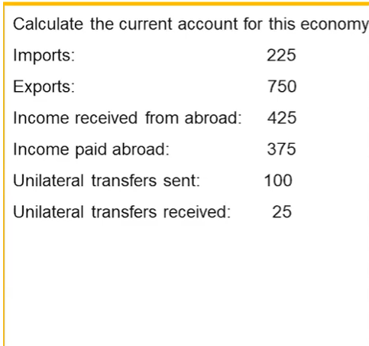
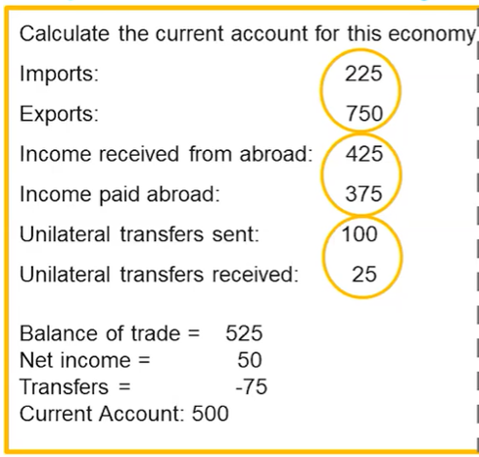
Calculate the current account balance.
Therefore, surplus.

Slide 15
Capital And Financial Account

Slide 16
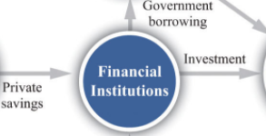



Capital Account / Financial Account
Summary
The capital and financial account includes financial investments and real investments.
The capital account represents the balance of investment. Investment can take many forms, including financial asset investment and investment in non-financial assets.
Net Financial Investments
Stocks, Bonds, Other financial assets
Buying and selling of stocks and bonds would move money in and out of the country.
Net Real Investments
Foreign Direct Investment (eg. factories, retail stores which are owned by the foreign company but operated locally)
Land (eg. A wealthy US family buys property in Mexico)
Property and Equipment (eg. A businessperson buys trucks which he rents to a delivery company.)
Nike Inc using its own money (financial capital) to open up its own store is an example of Foreign Direct Investment FDI
A foreign owned mining company would need to invest in equipment and machinery which would be a real investment inflow.

Slide 17
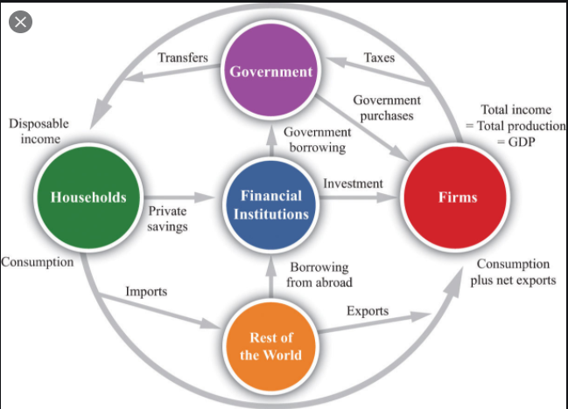

Capital Account and the circular flow
Capital/Financial Account

Slide 18
Capital and Financial Account (CFA) Balance
Just like the current account balance, the Capital Account also has a balance which can be in surplus or deficit.
Capital Account Balance
Capital account surplus - more money going into an economy for assets ie. Financial capital inflow
Capital account deficit – more money leaving the economy for assets ie. Financial capital outflow
Net Financial Investments
Net Real Investment
Money into the country (eg. Foreign investors buying company stocks in your country)
Money leaving the country
Investment into the country
Investment money leaving the country

Slide 19
Capital and Financial Account Balance
Summary
There is a capital and financial account balance.
Capital and Financial Account Surplus
More money enters the country.
This could mean:
High value of investment in the local economy by foreigners
Financial assets
Real Assets
Capital and Financial Account Deficit
More money leaves the country
This could mean:
High value of investment by locals in foreign countries
Investment
Investment

Slide 20
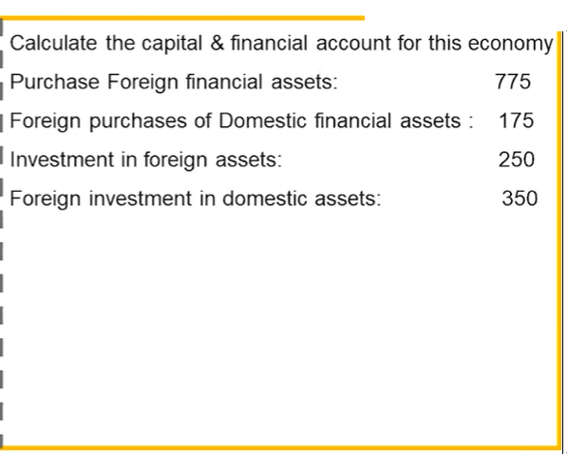
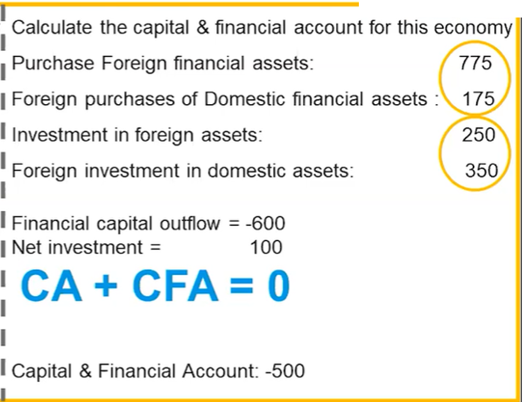

Surplus or deficit? Calculate the CFA balance.
Therefore, deficit.

Slide 21
Capital and Financial Account or Current Account
Classify the following as part of a nations’ current account or capital account.
The US donates money to Tonga after a huge volcano eruption.
A piece of furniture is exported to another country.
A Korean business opens a factory in Malaysia.
An Indian software developer provides service to an American firm.
An Australian buys Apple stocks on the New York stock exchange.
You are working in Germany and send money back to your family in China.
Current Account (transfer)
Current Account (goods)
Capital and Financial Account (Foreign Direct Investment)
Current Account (services)
Capital and Financial Account (Financial Assets)
Current Account (transfers)

Slide 22
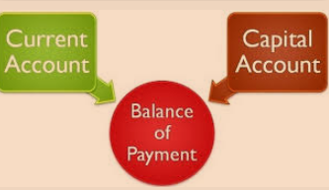

Balance of Payments = 0
Summary
Current account + Capital and Financial Account = 0
The balance of payments = 0 = Current Account + Capital and Financial Account
The money that enters the country must be equal to the money that leaves the country.
Increase in the CA balance must be offset by a decrease in the CFA balance
Increase in the CFA balance must be offset by a decrease in the CA balance.

Slide 23
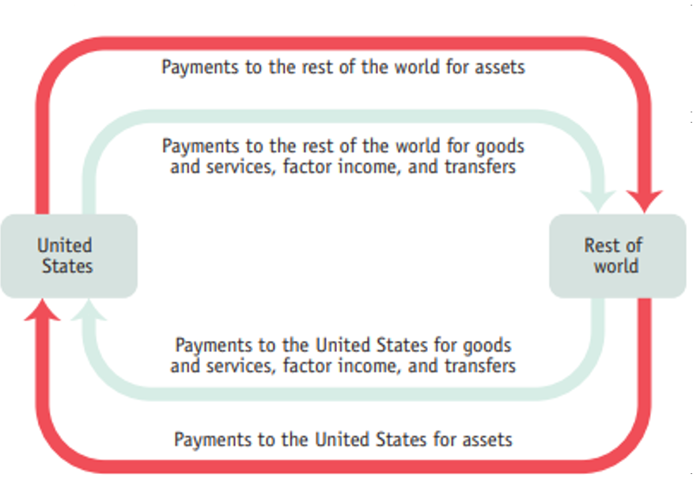
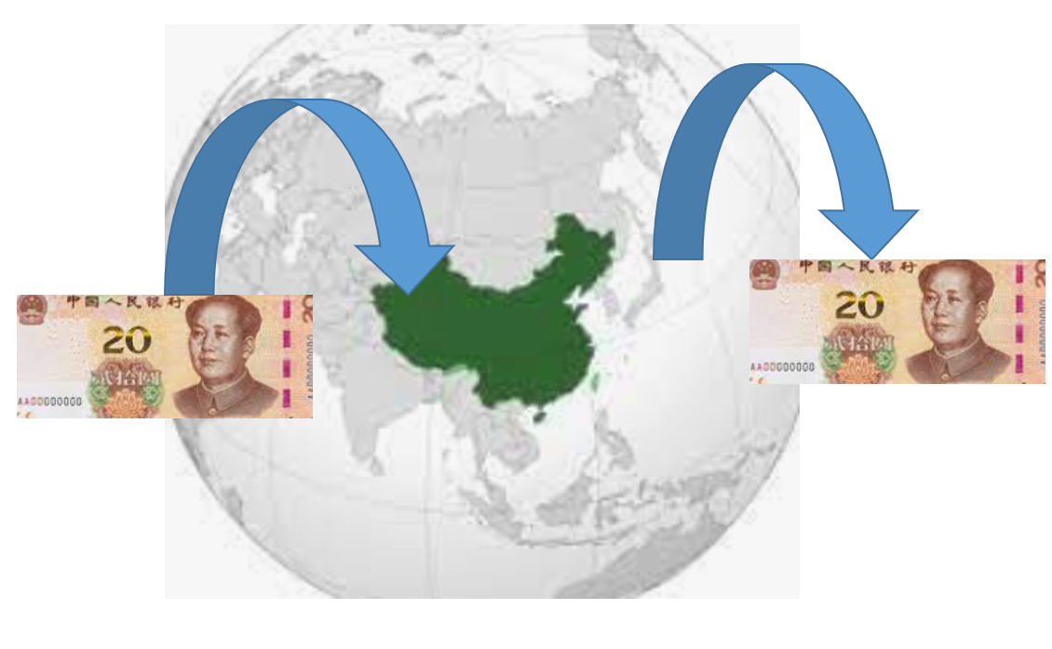
Balance of Payments
capital account
Remember that any flow of money in or out of a country falls under the capital and financial account or current account.
current account
Note: Not all investment is in the capital account. Eg. An American company buys a machine from Germany for use in the US – even though this is investment, it would be on the current account as an import.
However, if the American company invests in a machine IN GERMANY, then this is on the CFA.

Slide 24

Balance of Payments = 0
Summary
The balance of payments = 0
ie. Current Account + Capital Account = 0

Slide 25
What two accounts make up the balance of payments?
Current account and capital and financial account
Balance of payments = Current Account + Capital and Financial Account
What is the result when we add the current account and capital account?
0. Current account + Capital and Financial Account = Balance of Payments = 0

Slide 26
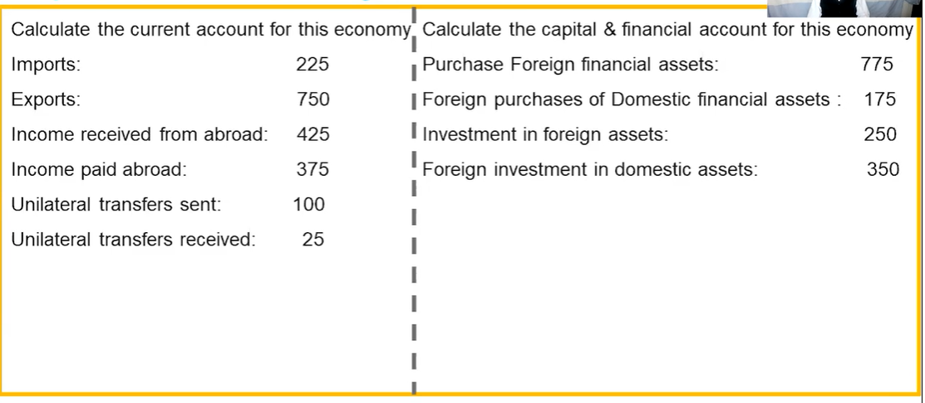
Calculate the Current Account, Capital and Financial Account and Balance of Payments

Slide 27

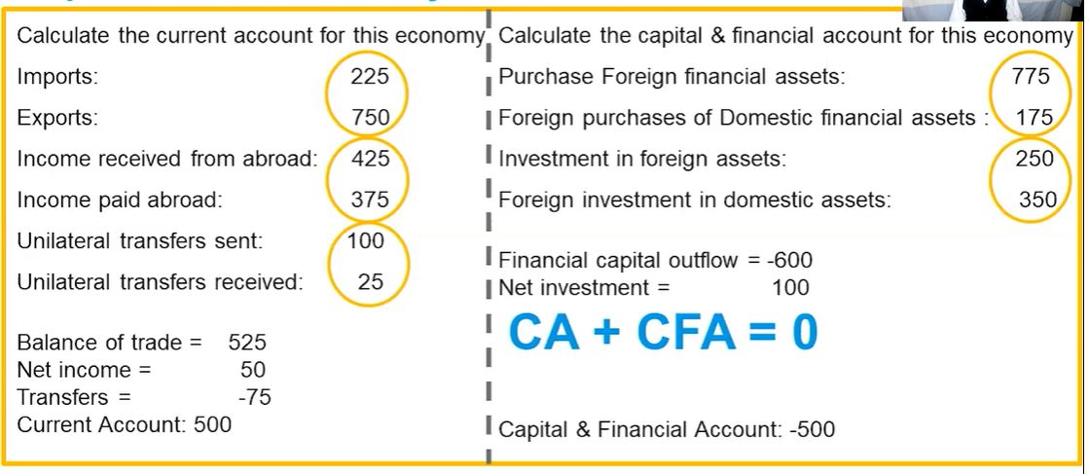

Slide 28

Credit and Debit
Summary
Credit = money leaves the country
Debit = money leaves the country
The terms credit and debit are accounting terms which we can apply to our study of the balance of payments.
In this case they are used to distinguish the direction of a money flow.
Credit = money enters the country
Examples
A Chinese business sells phones overseas = credit on the current account
Money enters China
An Australian buys Baidu stocks = capital account credit
Money enters China
Debit = money leaves the country
Examples
A Chinese student buys an apple computer = debit on the current account
Money leaves China
A Chinese person buys property in Malaysia = capital account debit
Money leaves China

Slide 29
If money enters a country as part of the current account, this is classified as a debit or credit?
Credit (= money enters the country)
If money flows out of a country as part of the capital account, this is classified as a debit or credit?
Debit (= money flows out of the country)

Slide 30
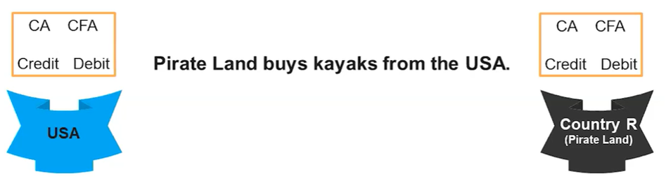
Example 1 – circle the correct entries

Slide 31
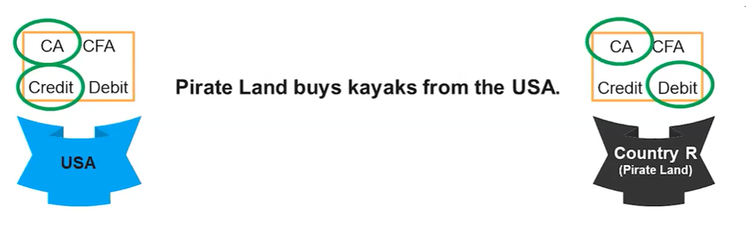
Example 1 Answer

Slide 32
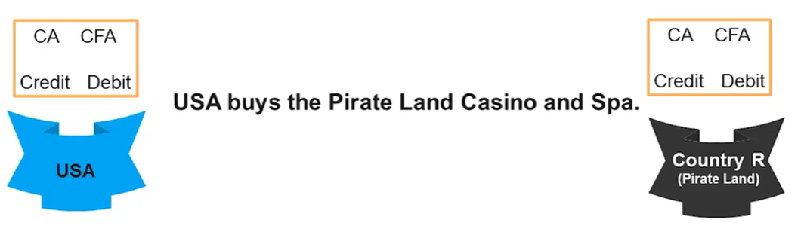
Example 2 – circle the correct entries

Slide 33
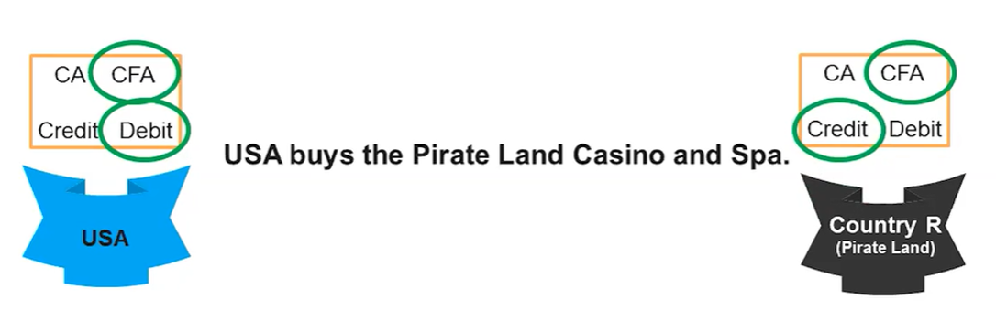
Example 2 Answer

Slide 34
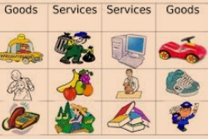

Balance of Payments = Current Account + Capital Account = 0
Balance of Payments Summary
In the long run the balance of money going in and out of the country is always equal!
Current Account
Net Exports/Trade Balance (X-M)
Net Factor Incomes (from ownership of land, capital and enterprise)
Net Transfers
Remittances
Foreign Aid
Capital and Financial Account
Net Financial Investments
Stocks, Bonds, Other financial assets
Net Real Investments
Foreign Direct Investment (eg. factories, retail stores)
Land, Property and Equipment
Surplus = positive
Deficit = negative
Credit vs Debit
Debit = Credit = money entering the country – Think: Extra credit
money leaving the country – Think: D = down

Slide 35
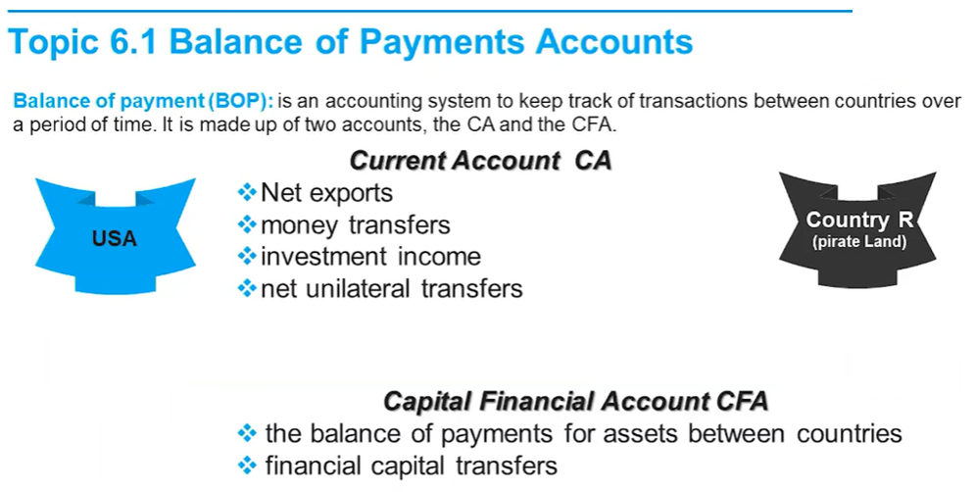
Summary 2: Balance of Payments

Slide 36
Current/Capital Account Surplus/Deficits
Summary
When one account is in deficit the other must be in surplus and vice versa.
Because the balance of payments = 0, then:
If the current account is in surplus, the other must be in deficit.
If the current account is in deficit, the other must be in surplus.
Current Account | Capital Account | Real World Example
Surplus Exports > Imports | Deficit More investment in foreign countries than in domestic markets. | China exports many products to other countries, and Chinese are using this money to invest in property etc. in these countries. A lot of property in Sydney, Australia is owned by Chinese investors.
Deficit Imports > Exports | Surplus More investment in foreign countries than in domestic markets. | The US imports more than it exports. Many foreigners lend money to the US and invest in US companies and property as well as lending to the US government by buying bonds.

Slide 37
Terms: Current Account = Balance of Payments?
Summary
Sometimes the balance of payments can refer to the current account, because the current account is a political issue in the US.
Sometimes you will see the ‘current account’ and ‘balance of payments’ used interchangeably.
This is because many people see the current account as the important part of the balance of payments.
Many cite a large current account deficit to be an unsustainable long term situation, as it may indicate a reliance on foreign production, and a loss of self sufficiency.
If a question refers to ‘a decrease in the balance of payments’. What will this usually mean?
A decrease in the current account – moving toward a current account deficit.

Slide 38
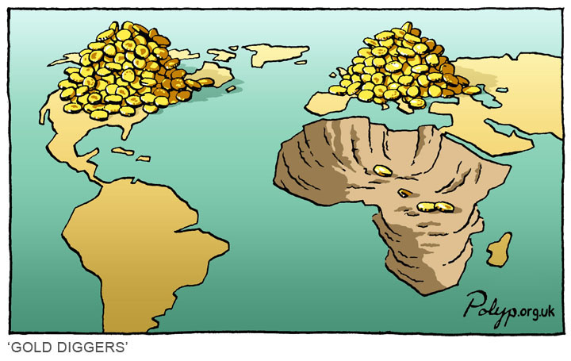


Current Account Surplus – Good and Bad
Mali (gold), Mauritania (iron ore), Mozambique (aluminium), Namibia (diamond, uranium, gold, and zinc), and Zambia (copper and cobalt)
These countries consistently export minerals, however many believe that they are being exploited by western mining companies who are simply taking the wealth and leaving, not creating any long term growth.
China, South Korea, Japan etc.
China’s growth has been fueled by export oriented growth which has developed the manufacturing sector and the middle class. Therefore they regularly have a current account surplus, which many see as a positive situation for China.

Slide 39
Define the following situation as ‘good’ or ‘bad’. (Note: This is normative in nature (personal opinion) but try your best all the same.)
A country consistently has a current account deficit, which it funds by selling all its property to foreigners to the point where locals have difficulty finding affordable accommodation.
A country consistently has a current account deficit, which is funded by large amounts of foreign investment which brings new technologies and creates jobs.
A country consistently has a current account surplus, which is caused by an increase in manufacturing exports that have created jobs and expanded the economy.
A country consistently has a current account surplus which is the result of raw material exports which will soon run out. Investors are wary of the long term sustainability of the country and choose not to invest.
Bad – the situation is not particularly sustainable.
Good – new technology and jobs will stimulate the economy.
Good – export lead growth can lead to advances in investment and productive capacity similar to that observed in China..
Bad – a country that is too reliant on raw material exports and has no long term investment will be left in a difficult situation once the materials run out.

Slide 40
A Wall Street Strategist Explains His Trade Deficit With Costco - YouTube
The argument for a U.S. trade deficit with China - YouTube

